Slide 1

Rain Team! Springfield, Illinois!

Slide 2
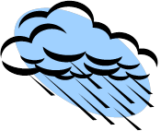
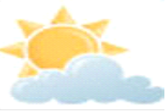
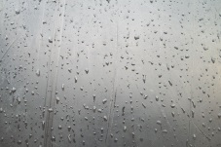
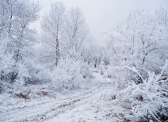
7-Day Forecast
Saturday | Sunday | Monday | Tuesday | Wednesday | Thursday | Friday
H:29 L:10 20% Snow 10 Mph Direction N | H:34 L:20 0% snow/rain 5 Mph Direction N NW | H:20 L:10 30% snow 3 Mph Direction S | H:5 L: -3 50% Snow 5 Mph Direction W | H:7 L:4 5% Rain 5 Mph Direction N | H:30 L:5 5% Rain 4 Mph Direction N | H:20 L:5 20% Snow 3 Mph Direction S

Slide 3
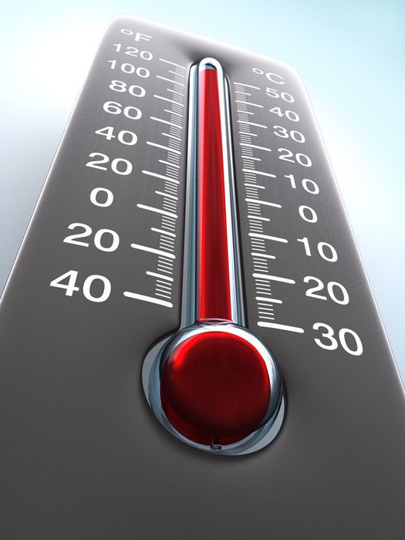
Thermometer
A thermometer is used to measure air temperature. It works because there is water inside of it and the air heats up the water and then makes the right temperature. You need to put it outside so it can do it’s job.

Slide 4
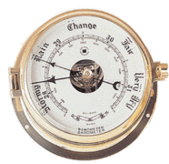
Barometer
A barometer measures the air pressure. If the air pressure is rising that means that outside it’s nice and sunny. If the air pressure is falling it means that it’s wet or stormy outside. This should also be outside.

Slide 5
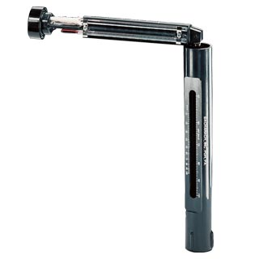
Sling Psychromotor
Sling psychomotors’ job is to measure using the cooling affect of evaporation. Two thermometers are used to make this tool.

Slide 6
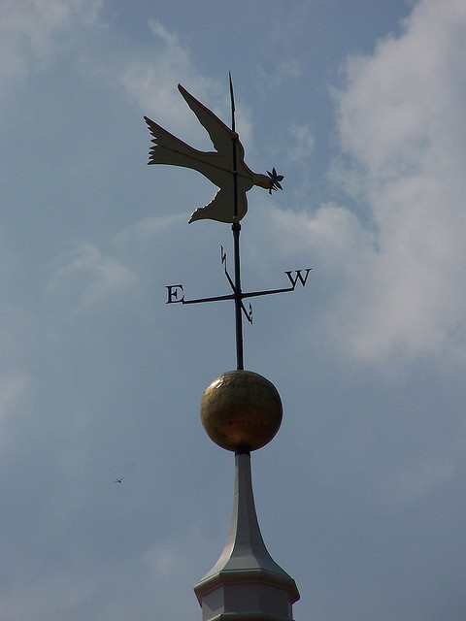
Wind Vane
A wind vane measures which way the wind is blowing, NW, SW, NE, SE, are the ways it measures. Wind vanes needs to go outside because the wind only blows outside.

Slide 7
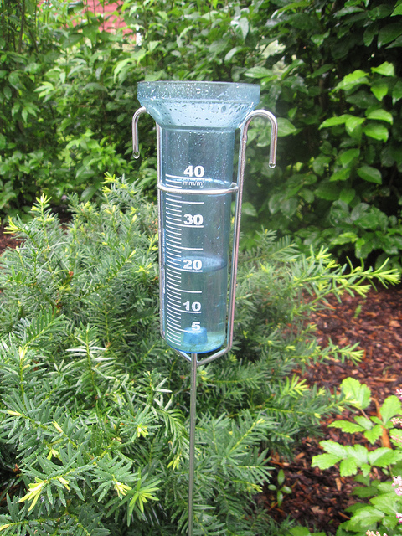
Rain Gauge
A rain gauge is supposed to go outside and it measures how much precipitation falls by inches.

Slide 8
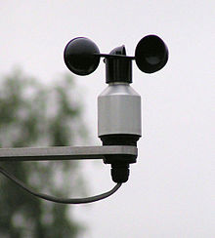
Anemometer
Anemometers measure how fast and what direction the wind’s going. A dial shows the wind speed, the dial gets turned on by a cup. Anemometers go outside.

Slide 9
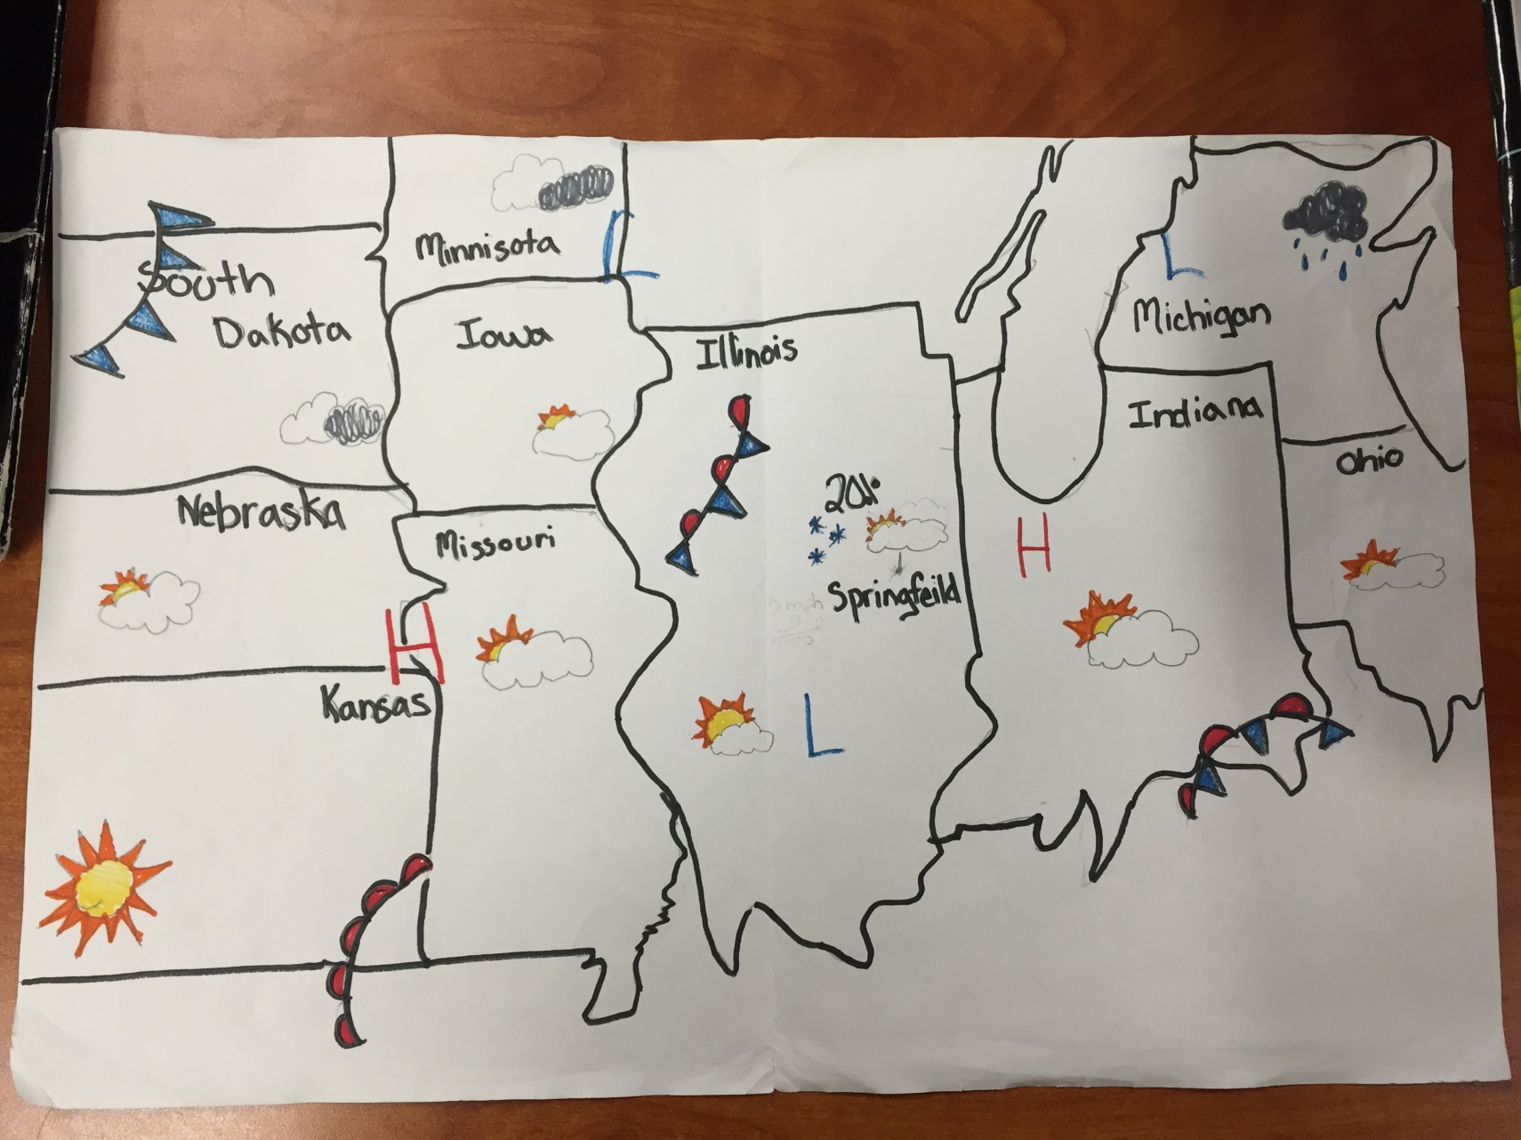

Slide 10
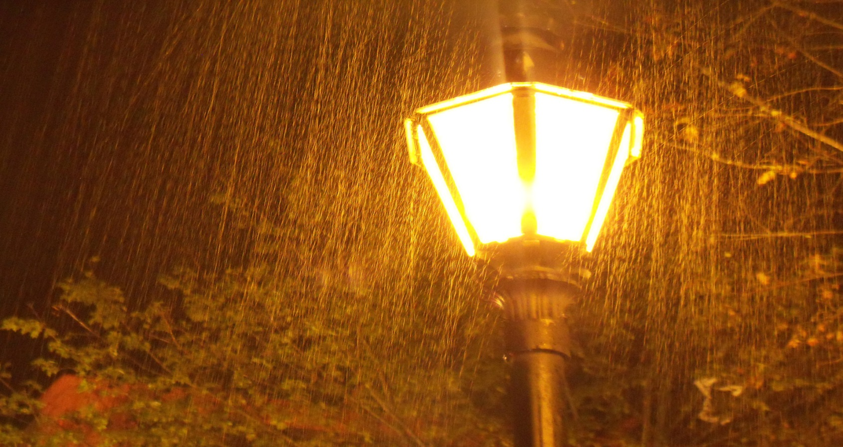
Thanks for Watching! Bye!

