Slide 1
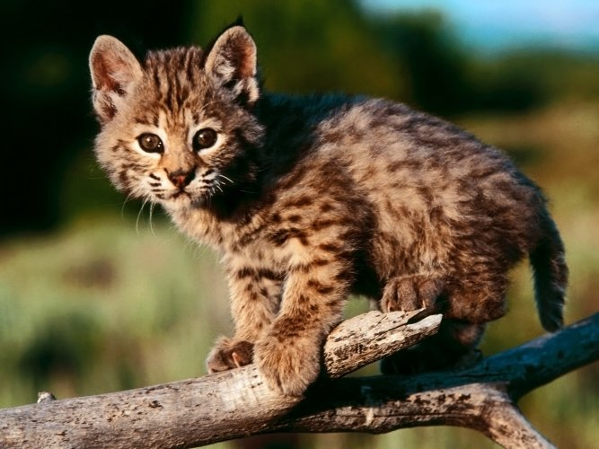
Grasslands Protection People
In the following slides you will learn some ways to protect grasslands, types of destruction, how destruction effects the grasslands, and how organisms adapt to destruction.

Slide 2
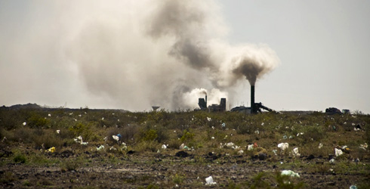
Types of Destruction
Types of destruction in the grasslands may be that people build farms or ranches. Plus, air used here (where you live) could end up in grasslands- animals might breath that air- and they might have issues because of that air. Animals need fresh air need fresh air just like humans do so that they can survive and since people pollute the air the animals breath might hurt them so by polluting the air it might hurt animals and by making farms and ranches that hurts animals because it makes it to where animals don’t have as much space for their habitat.

Slide 3
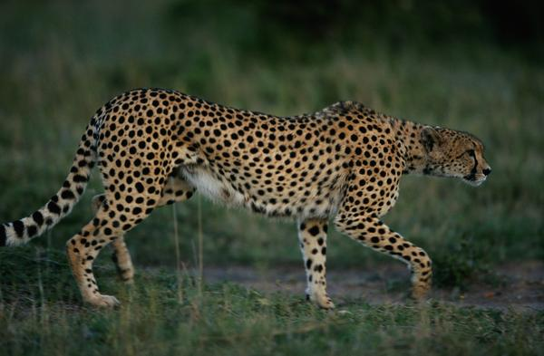
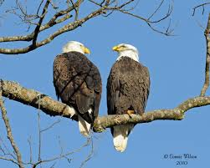
How does the Destruction Affect the Grasslands
Some of the destruction affects the animals by either forcing them to move to a different place or they stay there and die off in that area. A food chain is a thing where there are many animals the 3 body parts are, producers, consumers, and decomposers. A food chain starts with the Sun then you have a producer which in this case is a plant, then a consumer which is a herbivore, omnivore, or a carnivore. I am going to use a herbivore and an carnivore. The herbivore is a rabbit and the carnivore is a cheetah and eagle . First the rabbit eats the plants, then the cheetah kills the rabbit and the eagle eats the rest of what the cheetah does not eat, it will eat and the that is what a food chain is like.

Slide 4
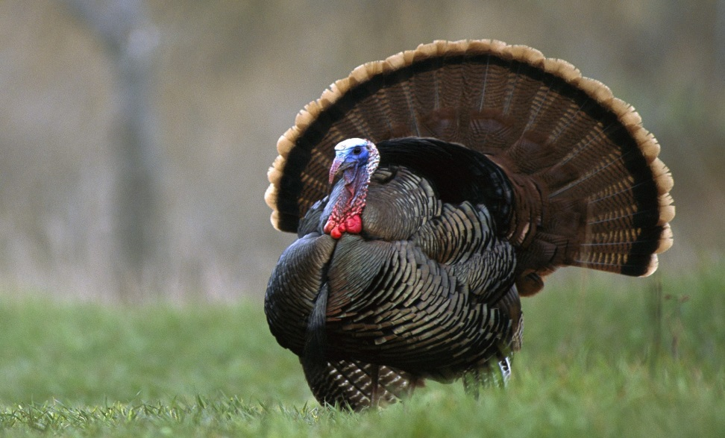
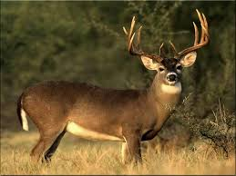
How Organisms Adapt to Destruction
How do the organisms adapt to destruction? They adapt by knowing when to move south to have enough water for the cold months. They also know when to move north for the summer to have enough grass for the warm months.

Slide 5
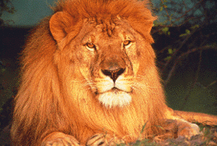
Some Ways to Protect the Grasslands
First way is to clean where animals live. Second way is plant grass where there is not any grass. Third way stop cutting trees and plant trees instead.

Slide 6
In Conclusion
So now you now some ways to protect grasslands, types of destruction, how destruction effects the grasslands, and how organisms adapt to destruction.

