Slide 1
NEBRASKA METEOROLOGISTS
Your weather for Lincoln, Nebraska.

Slide 2
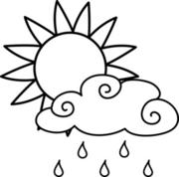
7-Day Forecast
Saturday | Sunday | Monday | Tuesday | Wednesday | Thursday | Friday
H: 37 L: 22 0% chance of rain NW 10 mph | H: 40 L: 32 0% chance of rain NE 12 mph | H: 32 L: 30 0% chance of rain SW 14 mph | H: 34 L: 29 2% chance of snow SW 15 mph | H: 28 L: 24 4% chance of snow NW 17 mph | H: 29 L: 25 5% chance of snow SE 19 mph | H: 30 L: 27 2% chance of snow S 15 mph

Slide 3
Thermometer
A thermometer is used to measure air temperature. It goes outside or inside on a wall. The air around it heats the tube and then the scale shows what the temperature it is.

Slide 4
WIND VANE
A wind vane shows which direction the wind is blowing. It goes on a roof. The directions are North, East, South, West.

Slide 5
RAIN GAUGE
It measures rain that falls from the sky in inches. It goes outside in the ground. It can go on a stick that is in the ground also.

Slide 6
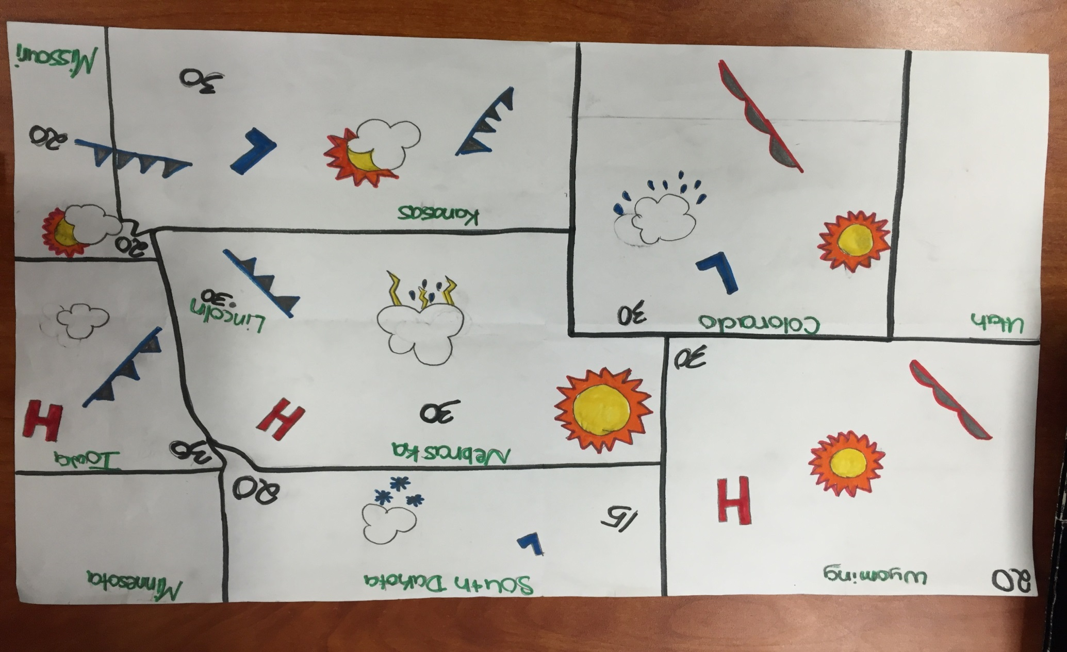
WEATHER MAP

