Slide 1
Team Name
Your weather for Cameron, Missouri

Slide 2
7-Day Forecast
Saturday | Sunday | Monday | Tuesday | Wednesday | Thursday | Friday
H: 41 L: 20 10% chance of rain NW 15 mph

Slide 3
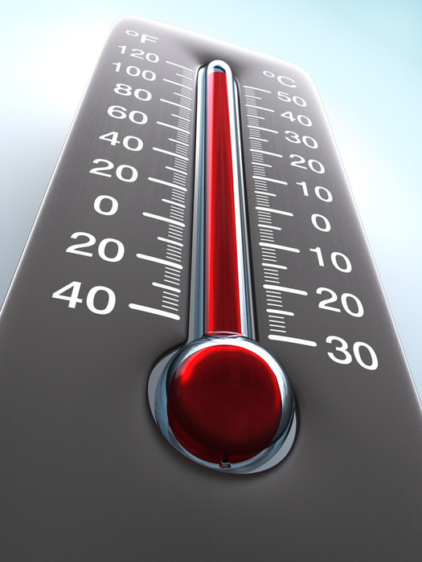
Thermometer
A thermometer is used to measure air temperature.

